Slide 1


Programming Fundamentals
Taimur Sajjad
MS(Data Science)
Lecturer (Computer Science),,
CUI Wah Campus

Slide 2
Computer Software System
Application Programs
(.cpp, .c, .java,)
2
Compilers / Libraries
(C++, C, Java)
Operating Systems
(Windows, Linux, MAC, Solaris)
Computer Hardware

Slide 3
Programming Languages
Classification of programming languages:
Machine language
Low-level languages
High-level languages
3

Slide 4
Machine Language
A computer understands only sequence of bits or 1’s and 0’s (the smallest piece of information)
A computer program can be written using machine languages (01001101010010010….)
Very fast execution
Very difficult to write and debug
Machine specific (different codes on different machines)
4

Slide 5
Low Level Language
English encrypted words instead of codes (1’s and 0’s)
More understandable (for humans)
Example: Assembly language
Requires: “Translation” from Assembly code to Machine code
5
Assembly Code
Machine Code
compare:
cmpl #oxa,n
cgt end_of_loop
acddl #0x1,n
end_of_loop:
Assembler
1001010101001101
1110010110010100
0101010111010010
0110100110111011
1101100101010101

Slide 6
High level Languages
Mostly machine independent
Close to natural language (English like language keywords)
Easy to write and understand programs
Easy to debug and maintain code
Requires compilers to translate to machine code
Slower than low-level languages
6

Slide 7
HLL
Procedural Language
Non-Procedural
Functional Language
OOP
7

Slide 8
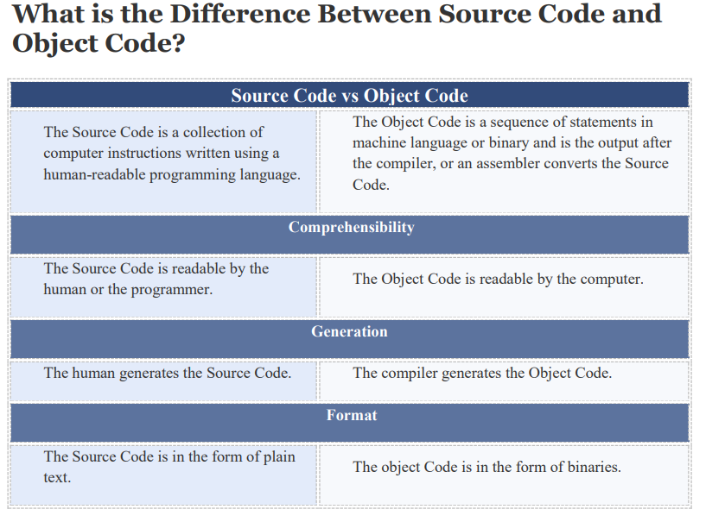

Slide 9
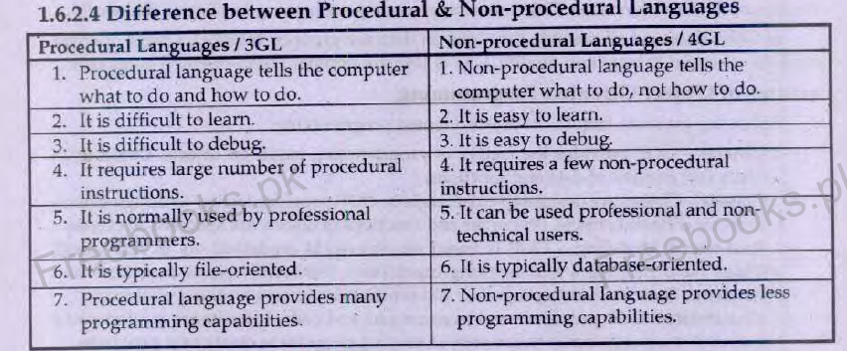

Slide 10
Language of Processor
Compiler
Interpreter
Assembler
9

Slide 11
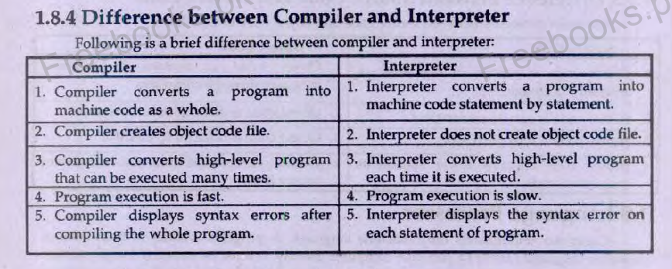

Slide 12
Thank You

